Slide 1

Understanding the Effectiveness of Different Machine Learning Algorithms for EEG Signal Classification
Tanmoy Sarkar Pias and Jesse Harden

Slide 2
Contents
Project Objective
Background
Dataset Overview
Literature Review
Methodology
Dataset Preprocessing
Experiment and Result
References

Slide 3
Project Objective
Understanding the effectiveness of different machine learning algorithms by testing them on different datasets with different configuration.

Slide 4
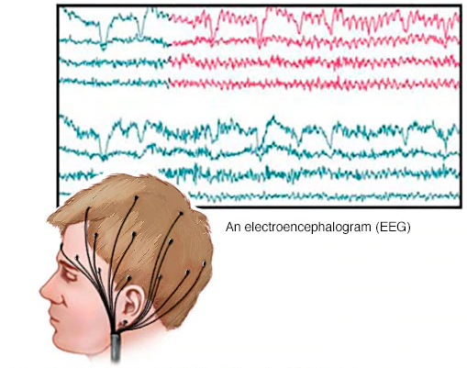
Background
Image ref: https://www.mayoclinic.org/tests-procedures/eeg/about/pac-20393875

Slide 5
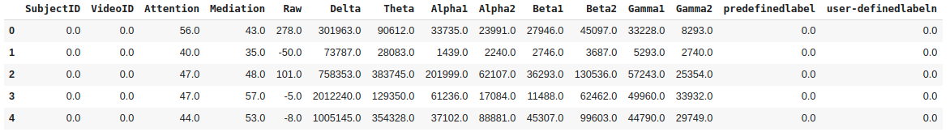
Dataset: Confusion-EEG dataset
Number of subjects: 10
Number of videos: 10
Duration: 1 minute
EEG device: 1 channel
Sampling frequency: 2-Hz
Total effective data-points: 100

Slide 6
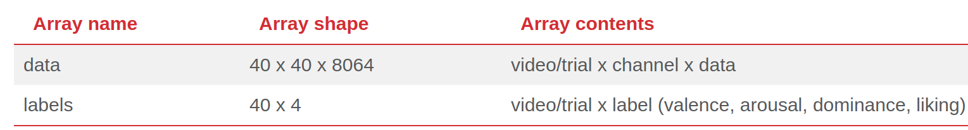
Dataset: DEAP dataset
Number of subjects: 32
Number of videos: 40
Duration: 1 minute
EEG device: 32 channel
Sampling frequency: 512-Hz
Total effective data-points: 8064

Slide 7
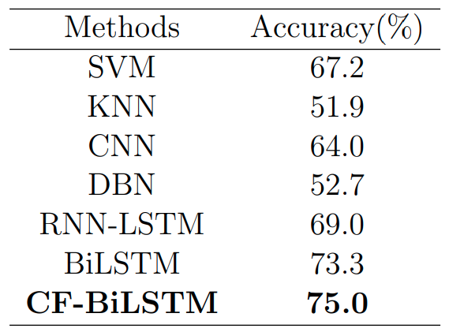
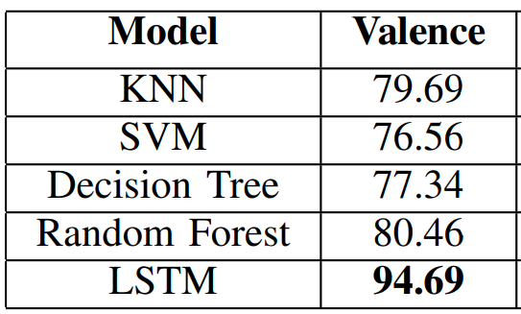
Literature Review: State-of-the-art Accuracy
Confusion-EEG dataset
DEAP-EEG dataset
Reference [7]
Reference [5]

Slide 8
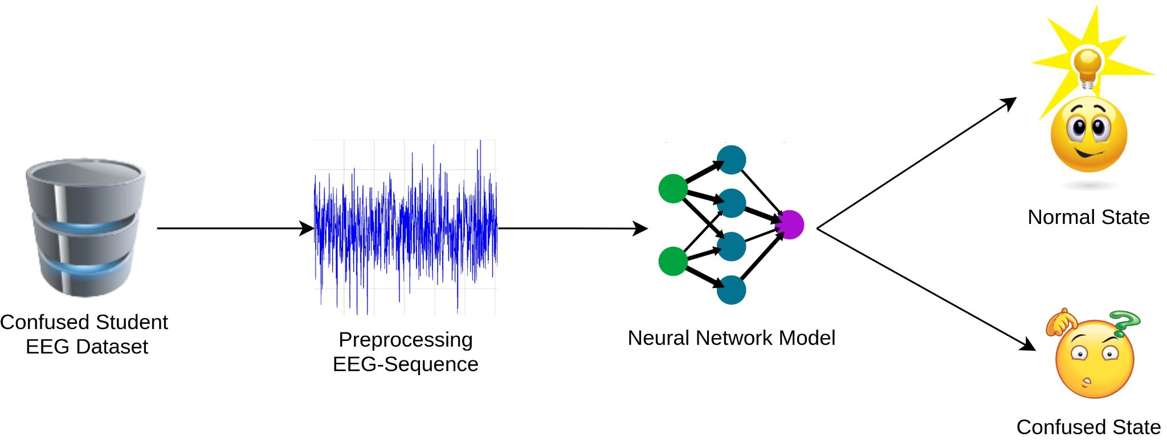
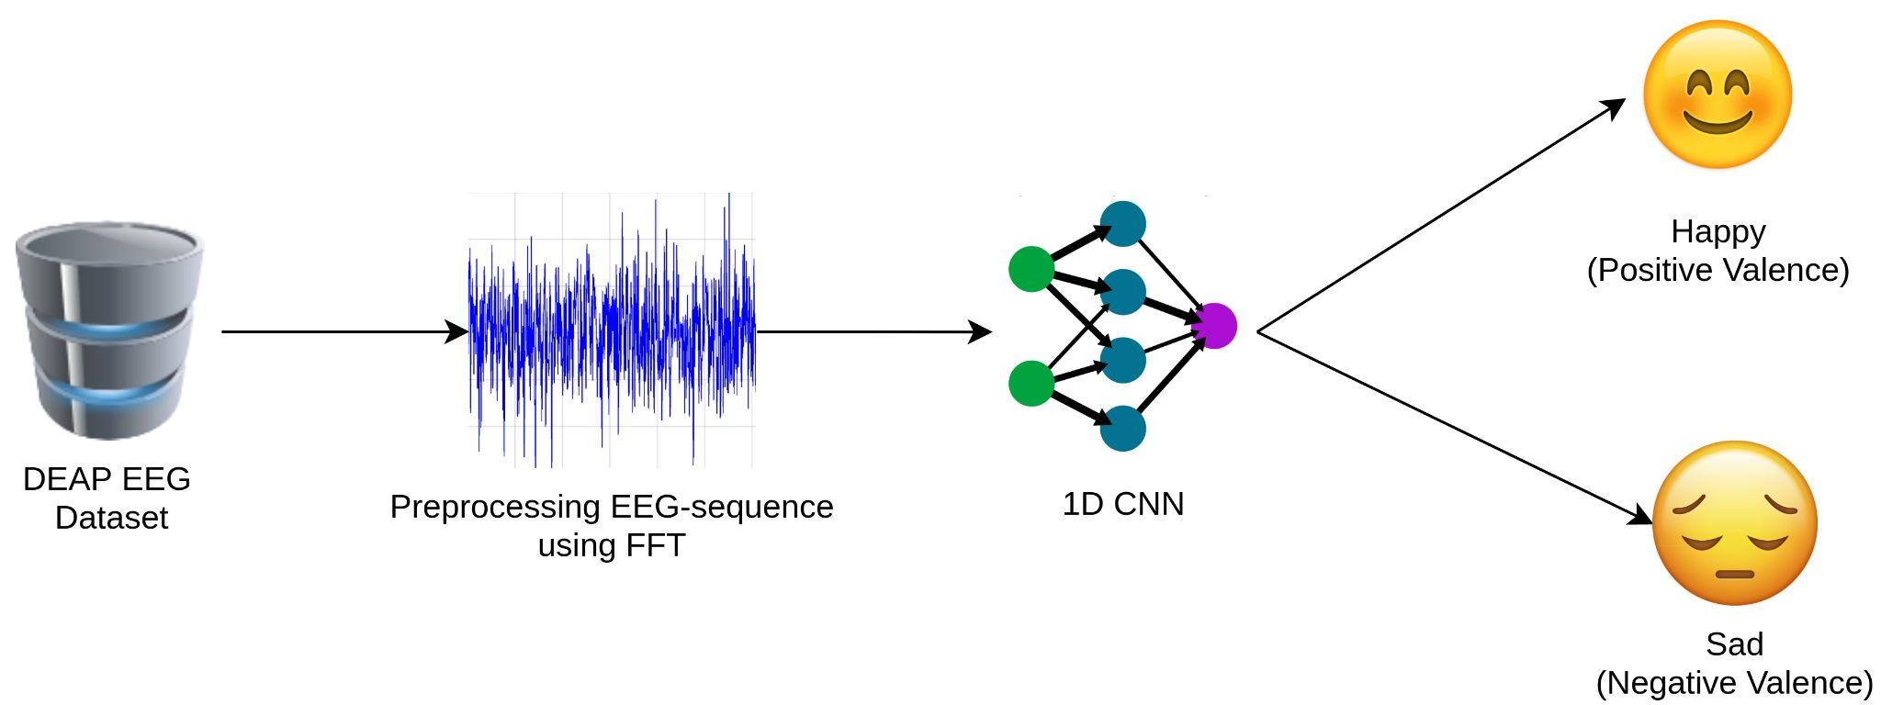
Methodology

Slide 9
Dataset Preprocessing: Confusion-EEG
After preprocessing:
The dataset matrix dimension becomes 100x112x11 where
100: 10x10 (Subject ID x Video ID)
112: minimal number of EEG sequence < 120 (60s x 2Hz)
11: Features
Removed ‘Predefined’ label column.
Creating a composite ID by merging ‘subject-ID’ and ‘video-ID’.
Balancing by taking minimal number of EEG sequence (112).

Slide 10
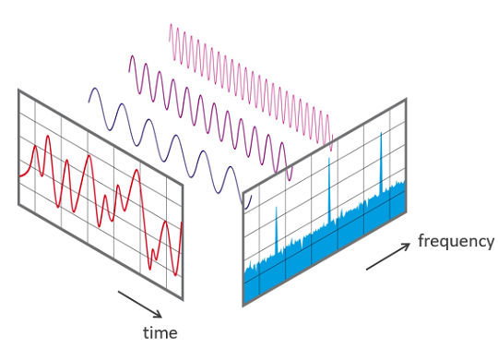
Dataset Preprocessing: DEAP-EEG
Pre-processed by Fast Fourier Transformation
FFT_Processing (dataset, channel, band, window_size, step_size, sample_rate)
#14 Channels chosen Empirically
channel = [1,2,3,4,6,11,13,17,19,20,21,25,29,31]
#5 bands
# delta (1–4 Hz), theta (4–8 Hz), alpha (8–13 Hz), beta (13–30 Hz), gamma (30–80 Hz)
band = [4,8,12,16,25,45]
#Averaging band power of 2 sec
window_size = 256
#Each 0.125 sec update once
step_size = 16
#Sampling rate of 128 Hz
sample_rate = 128
After Preprocessing:
FFT(dataset = 40x40x8064)
=> (546,560x70)
Total number of data-points = 546,560
Total number of fft features: 70
Image Reference: https://www.nti-audio.com/en/support/know-how/fast-fourier-transform-fft

Slide 11
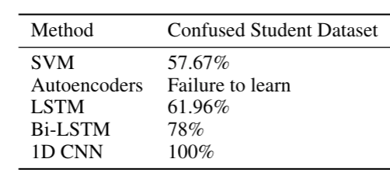
Experiments and Results
--------------------------------------------------------------
Method DEAP Dataset
-------------------------------------------------------------
1D CNN 94.4%
-------------------------------------------------------------
CNN Model Architecture
4 Conv Layers
3 Dense Layers
CNN Model Architecture
7 Conv Layers
1 Dense Layer

Slide 12
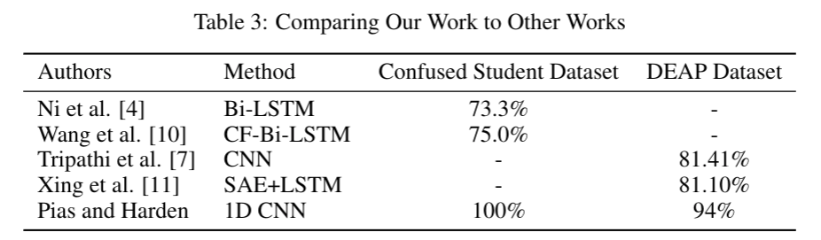
Experiments and Results
We achieved the best accuracy!!

Slide 13
Special Thanks to
For providing us with important guidelines and feedbacks
Instructor: Dr. Jia-Bin Huang
GTA: Yiran Xu and Akash Patil

Slide 14
References
H. Wang, Y. Li, X. Hu, Y. Yang, Z. Meng, and K.-m. Chang. Using eeg to improve massive open online courses feedback interaction. In AIED Workshops, 2013.
W.-J. Yoon and K.-S. Park. A study of emotion recognition and its applications. In International Conference on Modeling Decisions for Artificial Intelligence, pages 455–462. Springer, 2007.
F. Cavallo, F. Semeraro, L. Fiorini, G. Magyar, P. Sinˇcák, and P. Dario. Emotion modelling for social robotics applications: a review.Journal of Bionic Engineering, 15(2):185–203, 2018.
S. Koelstra, C. Muhl, M. Soleymani, J.-S. Lee, A. Yazdani, T. Ebrahimi, T. Pun, A. Nijholt, andI. Patras. Deap: A database for emotion analysis; using physiological signals.IEEE transactions on affective computing, 3(1):18–31, 2011.
Nath, Debarshi, Mrigank Singh, Divyashikha Sethia, Diksha Kalra, and S. Indu. "An Efficient Approach to EEG-Based Emotion Recognition using LSTM Network." In 2020 16th IEEE International Colloquium on Signal Processing & Its Applications (CSPA), pp. 88-92. IEEE, 2020.
Ni, Zhaoheng, Ahmet Cem Yuksel, Xiuyan Ni, Michael I. Mandel, and Lei Xie. "Confused or not confused? Disentangling brain activity from EEG data using bidirectional LSTM recurrent neural networks." In Proceedings of the 8th ACM International Conference on Bioinformatics, Computational Biology, and Health Informatics, pp. 241-246. 2017.
Wang, Haohan, Zhenglin Wu, and Eric P. Xing. "Removing confounding factors associated weights in deep neural networks improves the prediction accuracy for healthcare applications." In BIOCOMPUTING 2019: Proceedings of the Pacific Symposium, pp. 54-65. 2018.

